Slide 1
Agile Presentation
SNHU Travel – SCRUM Agile

Slide 2
Scrum-Agile Team Roles
The Scrum Master is responsible coaching the team to be self-sufficient, helping the product owner with backlog management, and training the organization in Scrum principles. Without the Scrum master the team is denied a portion of accountability and Scrum-agile knowledge.
The Tester breaks away from traditional software development principles and focuses on assisting in quality assurance, continuous testing, and short feedback loops. They are essential to providing a complete and bug-free product.
The Developer is an integral part of the team; tasked with assisting in the creation of the Sprint plan, adapting their plan daily based on scrum meetings, and holding each other accountable. The developers give the product backlog and user-stories life, without them, there is no product.
The Product Owner is responsible for maintaining the Product Backlog, communicating the product goal, and creating the backlog items. The product owner is essential as they act as the bridge between the developers and the users/stakeholders.
(Schwaber & Sutherland. 2020)

Slide 3
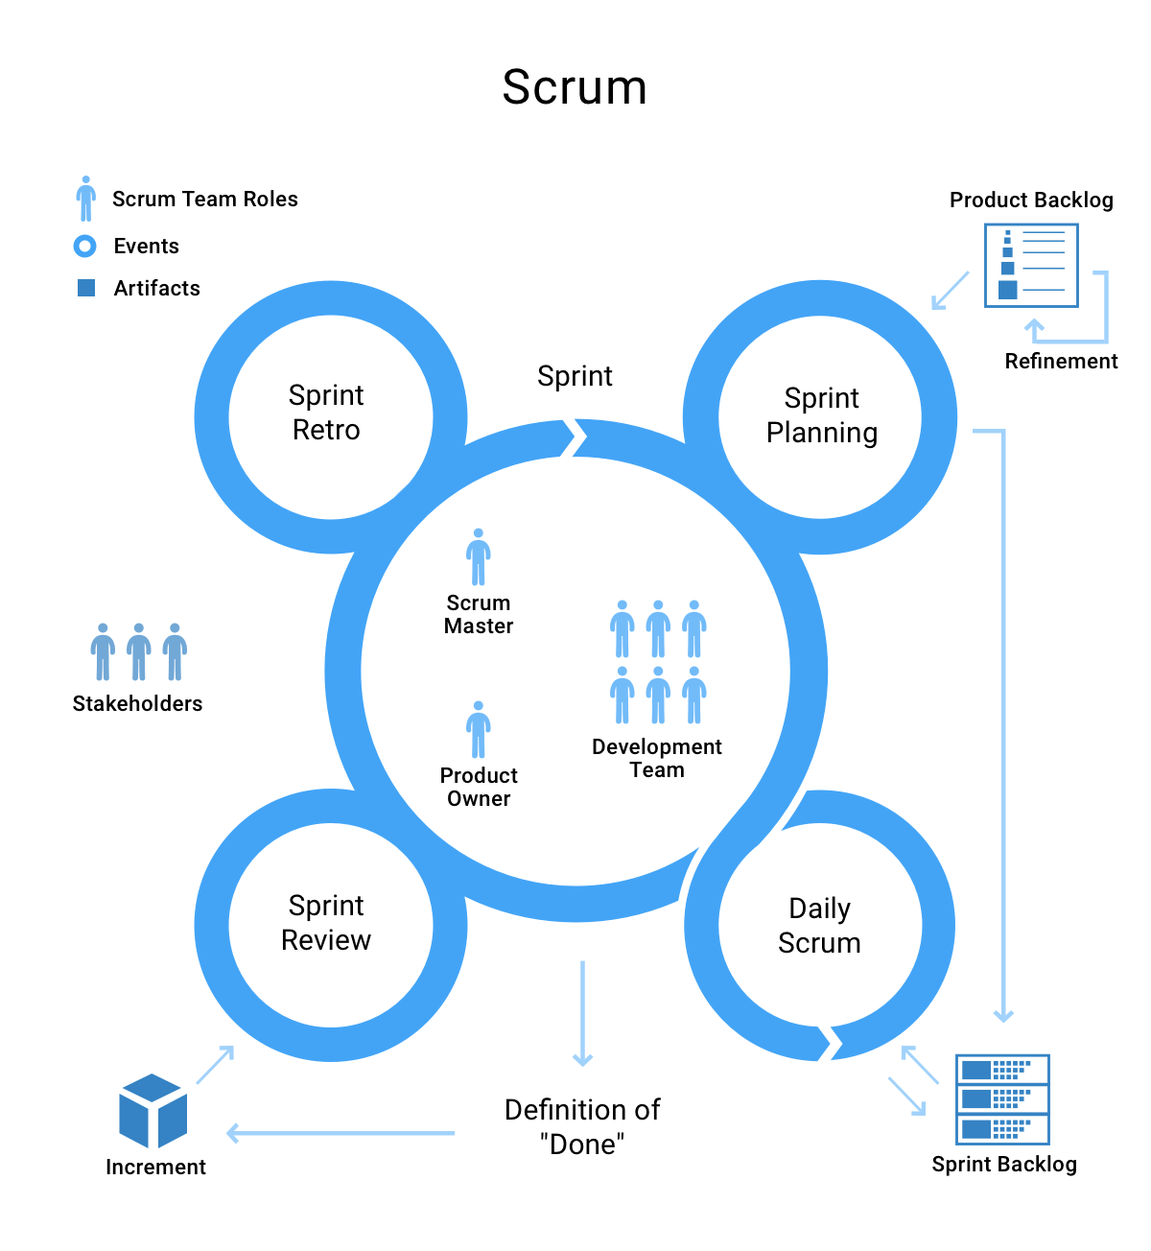
Scrum-agile Phases
The sprint planning, lays out the ground work for what needs to be accomplished during the sprint.
The sprint is a fixed length event, e.g. one week, during this event each other event takes place.
The Daily scrum is a daily meeting, usually involving the developers/testers and scrum master. These meetings help hold the team accountable, and plan their work for the day.
The sprint review is an opportunity to reflect on the sprint and use the results to plan the next steps.
Lastly, the sprint retrospective builds on the sprint review and is used to find ways for the team to work more efficiently.
(Feoktistov, 2020)

Slide 4
Comparing Approaches
Waterfall
Scrum
As the name implies, the waterfall methodology starts from the product’s conception and follows a fixed track until the end.
The product owner tends to only meet with users/stakeholders in the beginning of the process.
Testing doesn’t take place until development is done.
Example:
When SNHU Travel shifted from vacation destinations to wellness resorts, the product would have been all but completed, leading to a long arduous change that would have pushed back the release and finished with an inferior product.
Scrum-agile development takes place in fixed length sprints, each one almost containing everything from a waterfall methodology.
Product owner meets with users/stakeholders at the end of each sprint or even more.
Testing is engrained into the development process.
Example:
When SNHU Travel shifted from vacation destinations to wellness resorts, the team was able to change direction easily and efficiently. Resulting a in a complete product releasing on time.
(Ghahrai, 2017)

Slide 5
Considerations
The Scrum-agile method worked wonders for the SNHU Travel project and team though that had to do with many factors, including the size, audience, release schedule, and more.
When contemplating the methodology to implement I would first consider the size of the product, SNHU Travel could have worked with a waterfall methodology due to its smaller size but the larger the project is, the more downsides waterfall includes.
The users is another consideration, is it a template software that will be utilized and tweaked by dozens of different companies with different needs? Or is it a specialized software made for a specific market?
Lastly, team-size is an important aspect to consider. SNHU Travel had a small team that did not require to be broken up but a larger project may have a much larger team that requires a different implementation, the two-pizza rule for example.

Slide 6
References
Feoktistov, I. (2020, November 05). Agile software development LIFECYCLE Phases explained. Retrieved February 20, 2021, from https://relevant.software/blog/agile-software-development-lifecycle-phases-explained/
Ghahrai, A. (2017, January 06). Agile testing mindset and the role of the agile tester. Retrieved February 20, 2021, from https://devqa.io/agile-testing-mindset-tester-role-agile-team/
Schwaber, K., & Sutherland, J. (2020). The 2020 Scrum GuideTM. Retrieved February 20, 2021, from https://www.scrumguides.org/scrum-guide.html

